Slide 1



Digital transformation is cool
Nikola Matić
Consultant Engineer
Oporto, Portugal October 17-18, 2019

Slide 2
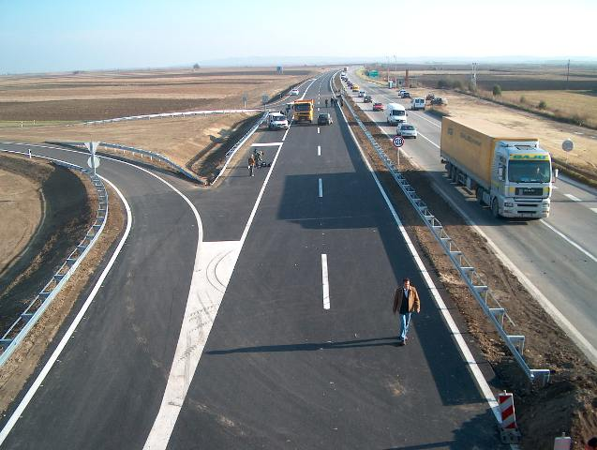
Outlines
Introduction to Company VMS
Life Cycle and Digitalization
Data driven decisions
QL construction trends
People in focus – shifting workforce

Slide 3
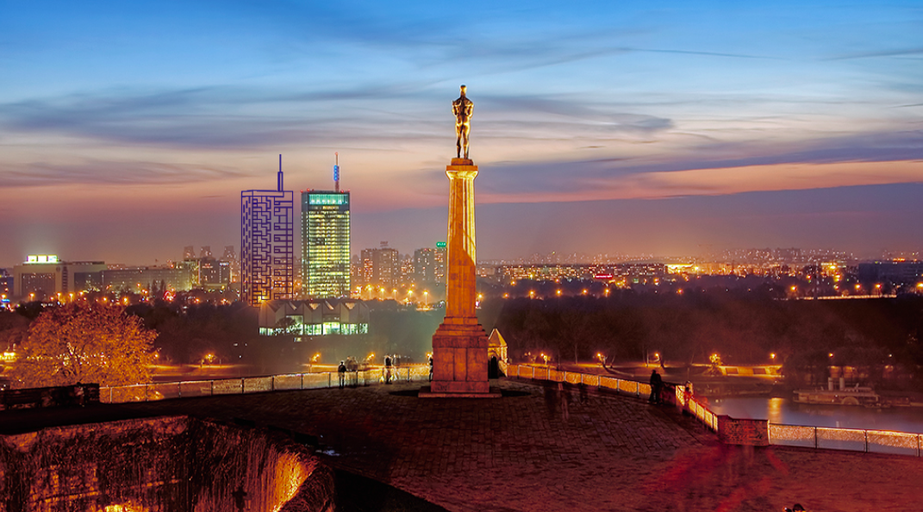

VMS Beograd – one of leading consultant engineers company in Serbia and the Balkan region dedicated to support our clients to deliver projects on time, within the budget and with significantly reduced risk
  Project & Contact Management
  Design & Supervision
  Claim Management
  SHM and IoT
  3D Scanning

Slide 4
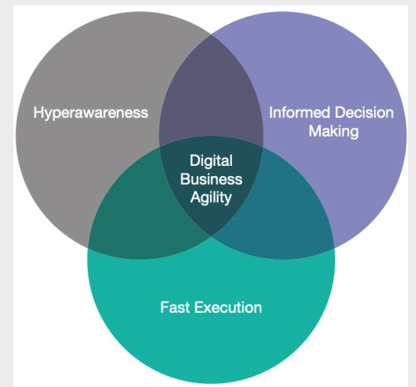
Definition
Digital Business Transformation is Organizational Change
through the use of Digital Technologies and
Business Models to improve Performance

Slide 5
Digital Transformation
For the successful Digital transformation one should include >
People
Strategy
Cooperation
Technology

Slide 6
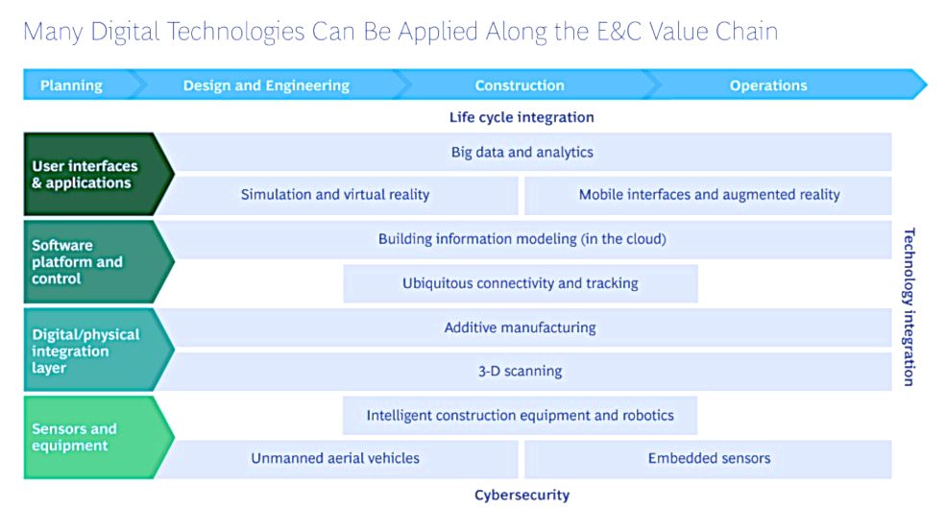
Digitalization in Engineering & Construction
Source : BCG
Notes:
The engineering and construction (E&C) industry has been slow to adopt new technologies and has never undergone a major transformation.
Substantial change is on the way, however, driven by digitization
This is what digitalization in E&C is bringing if we look though the whole value chain from planning, design, construction and operations:
Starting from sensors and equipment we have more embodied sensors in infrastructure – bridges, tunnels, buildings, we have drones that are doing supervision, equipment is becoming more intelligent with embodied sensors too…
There is integration between digital and physical – addaptive manufacturing – one example is 3D printing – or posibility to in few minuted use equipment for 3D scanning of the objects
When it comes to SW tools – of Course use of BIM in the cloud with all additional real time cooperation – and fact that you can be anywere, any time use any of moble device you have and with mobility, bouadband and cloud you can stay updated with the latest changes on your design, or project
All this data colected from sensors should be analized and there is on this user interface also use of virual reality and augmented reality that i will talk more about soon.
Additive Manufacturing (AM) is an appropriate name to describe the technologies that build 3D objects by adding layer-upon-layer of material, whether the material is plastic, metal, concrete or one day…..human tissue.
Common to AM technologies is the use of a computer, 3D modeling software (Computer Aided Design or CAD), machine equipment and layering material. Once a CAD sketch is produced, the AM equipment reads in data from the CAD file and lays downs or adds successive layers of liquid, powder, sheet material or other, in a layer-upon-layer fashion to fabricate a 3D object.
The term AM encompasses many technologies including subsets like 3D Printing, Rapid Prototyping (RP), Direct Digital Manufacturing (DDM), layered manufacturing and additive fabrication.
AM application is limitless. Early use of AM in the form of Rapid Prototyping focused on preproduction visualization models. More recently, AM is being used to fabricate end-use products in aircraft, dental restorations, medical implants, automobiles, and even fashion products.
http://additivemanufacturing.com/basics/
3D Scanning
http://www.3dsystems.com/shop/sense
http://www.dirdim.com/lm_everything.htm

Slide 7
4 principle strategies to capture value
… from available technologies in construction industry
Which one of these answers best fitting your present style?
(Honest answers required, please ☺)
No need for change - We delay implementation as much as possible
We relay on our partners to create new value
We are front runners introdusing new solutions
We are creating an Eco system with others
Notes:
Now it is a time to think where each of you and your company are in terms of new technology use.
So, honest answers required. Let’s face reality.
Society needs Engineers and their innovative approach and solutions.
Our task group will try to convince you to rethink your

Slide 8
… Let’s get back to reality!
Our Clients are expecting
GOOD ○ FAST ○ CHEAP
In reality one can deliver two of expected
Good & Fast won’t be Cheap
Fast & Cheap won’t be Good
Good & Cheap won’t be Fast
… if we firmly set goals, it might be achievable with fresh ideas and use of technology?

Slide 9
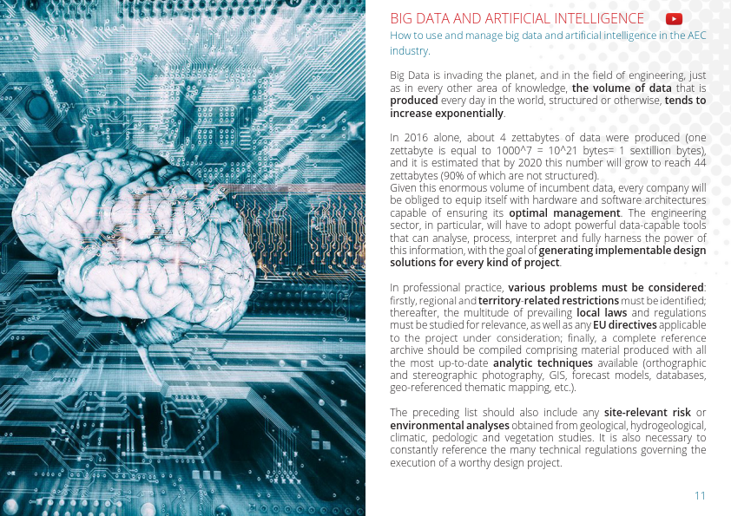
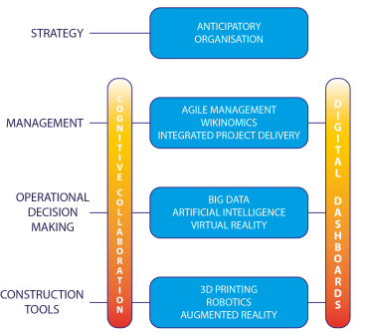
Data driven decisions – collect real time DATA

Slide 10
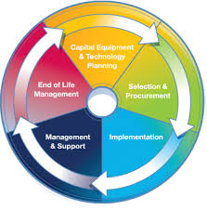
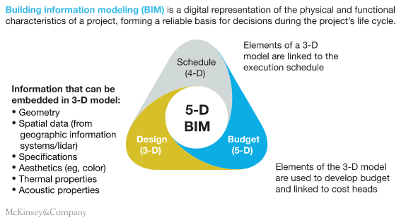
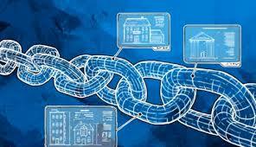
Sustainable & Smart Approach
LCC Strategy – holistic approach for Investment planning, including O&M
BIM – reduce time consumption in design process, better coordination and compatibility
IoT – Site supervision monitoring, predictive and preventive maintenance, O&M and Structural Health Monitoring
Blockchain technology – reliable data transfer and storage, protection of the intellectual properties
Collaborative Engineering – shift from competitive to collaborative, knowledge sharing
Notes:
Now everybody is talking about efficiency, smart this, smart that … actually Investors are looking for quick, cheap and efficient.
Depending on type of the investment, sometimes Investors are looking for sustainable technical solution giving them better ratio for RoI.
Energy and environmental aspects are being in a focus to those firms that are social responsible.
Politicians and bankers are always looking to accommodate principle ”best value for money”.
Best practise, can not help much – we have to include available technology and change way of thinking, and style of company operation.
Osnovni ciklus je dat na slajdu, pocevsi od
Life cycle strategy koja definise O&M troskove
BIM ce nam pomoci oko preciznijeg sprovodjenja O&M plana
Uz IoT cemo biti u mogucnosti da merimo prethodno zadate vrednosti I donosimo pravilne odluke
Koriscenjem Blockchain technology mozemo biti prilicno sigurniji da nece biti zloupotrebe prikupljenih I arhiviranih podataka

Slide 11

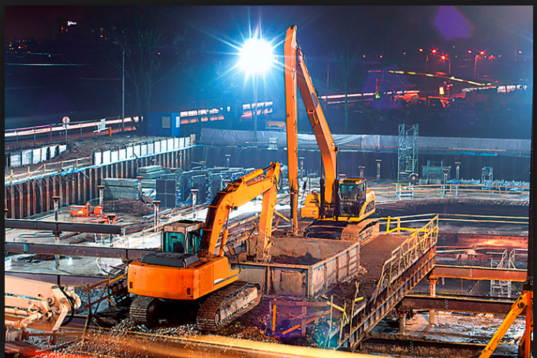
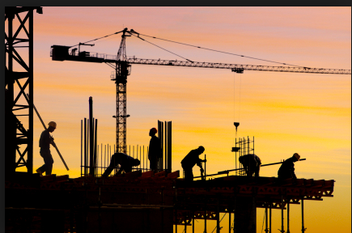
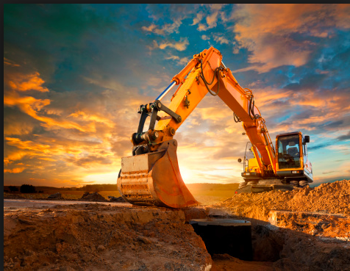
Construction Site Monitoring
Notes:
So many more to see on the construction site monitoring using sensors, cameras, workforce monitoring, drones…

Slide 12
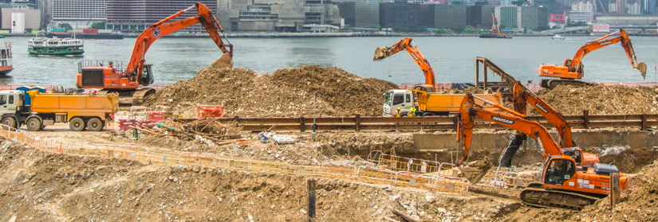
IoT for Construction Site Monitoring
Camera surveillance, intruder detection, Workforce surveillance
Sensors for temperature, humidity, noise , vibration, health & safety risk
GPS for vehicles, tools, machinery
Control of idle use of machinery, air-conditioning, fuel level control
Monitoring the ground in terms of geometry change - sensors can provide early warnings
Use of aerial drones - best way to track progress and conduct site surveys
VMS IoT
Notes:
…and here are the drivers for this growth / ..
Minimizing theft through better site security
Site security is the main driver for the deployment of IoT monitoring applications. Theft of equipment and materials is a major issue for construction companies of all sizes and, while the sector has historically been slow to adopt new technologies, IoT is now gaining traction.
Estimates from Dewalt, a leading US power tool manufacturer, suggest that USD1 billion worth of construction plant and equipment is stolen each year in the US and, according to The National Association of Home Builders of Washington, D.C., building site theft adds at least 1% to the price of a new home. The UK government in 2013 estimated that theft from construction sites was worth £1m week, of which less than 10% is ever recovered. Allianz Cornhill, an insurance company, estimated in 2014 that some GBP 70 million of construction equipment had been stolen from construction sites in the UK over the previous year with total associated losses in the region of GBP 800 million once replacement costs, increased insurance premiums and lost business were taken into account.
Extending the life of plant and equipment
Using IoT to connect plant and equipment provides an opportunity to extend their lifetimes through more timely maintenance, facilitated by remote diagnostics and monitoring.
Noise pollution regulation
Regulation is becoming another driver as Europe and the US are introducing regulations covering noise pollution that require noise and vibration levels generated by equipment on building sites to be monitored. Such monitoring also provides data that can be used to respond to complaints or as evidence should legal action be taken against construction companies.
Streamlining the construction process
Use of sensors can help to eliminate mistakes such as pouring concrete when the weather is too cold, which can help projects to come in on time and on budget. Since construction contracts often include significant penalties for overruns, this is valuable functionality.

Slide 13

Structural Health Monitoring
Infrastructure Owners:
Extend life of Infrastructure
Decrease cost of Operation
Increase Safety
Operators of Infrastructure:
Efficient O&M
Preventive Maintenance
Early warning – lower cost
Designers & Contractors:
Verification of innovative design
Lower Risk During Construction
Insurance Companies:
Easier Risk assessment
Notes:
But for structural engineers this is most important topics when we talk about sensor in construction sector / SHM
So if we take from different angles what are the benefits of SHM…

Slide 14
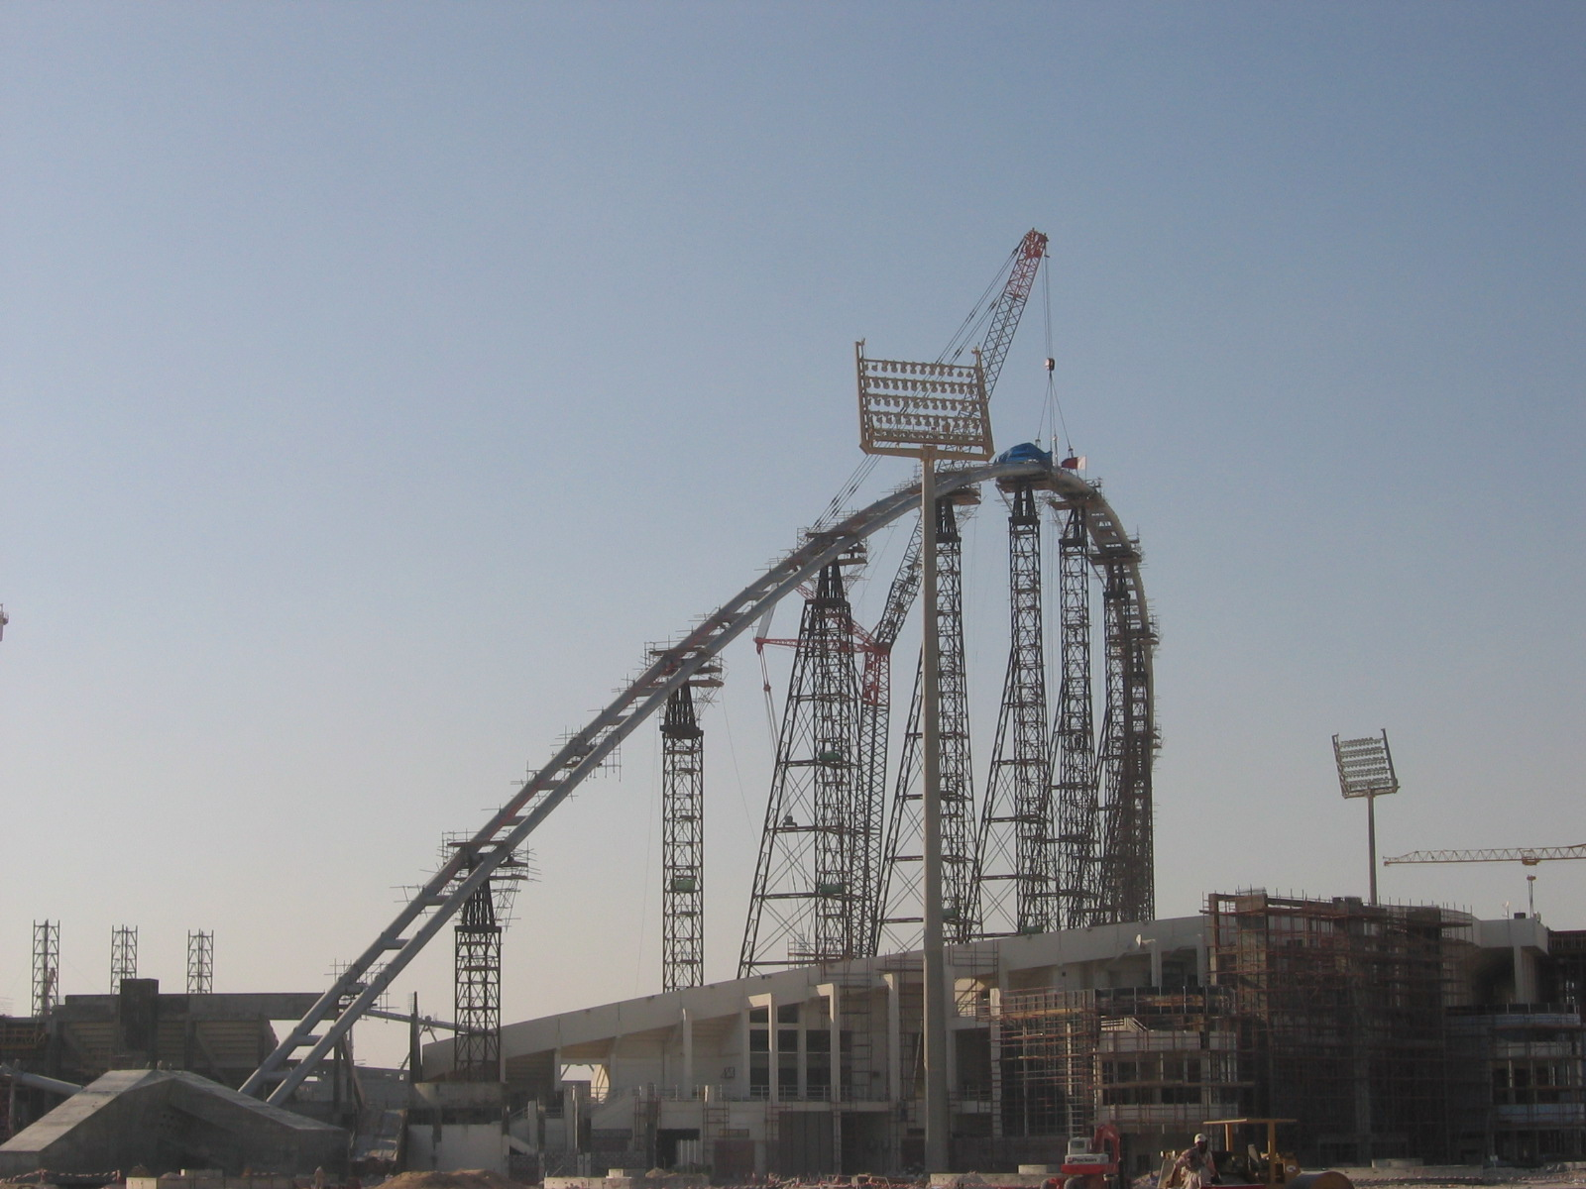
Focus on cool construction trends
The Cloud - the process of project dematerialization, the transition from paper to digital media
The Platform - all documentation, notifications and information exchanges must be managed by a specific platform that utilizes the cloud to coordinate all processes in real time by means of a reliable and controlled system
The Dashboard - provides real time information that the team can use to adjust its delivery process midstream // use Plan-Do-Study-Act cycle to continuously improve
The Smart Contracts - executes and enforces its clauses without external intervention. The Blockchain's mission is to manage work packages that are triggered automatically, because the Smart Contracts are actually generated during the initial design phase in BIM.
The Internet of Things – data driven decisions
Blockchain Technology - we can record all construction site events on non-editable media - a Ledger of Things
Crowdsourced Justice - should disputes arise, rather than appealing to the conventional judicial system, justices of the peace or civil arbitration, an alternative could be the crowdsourced justice approach

Slide 15
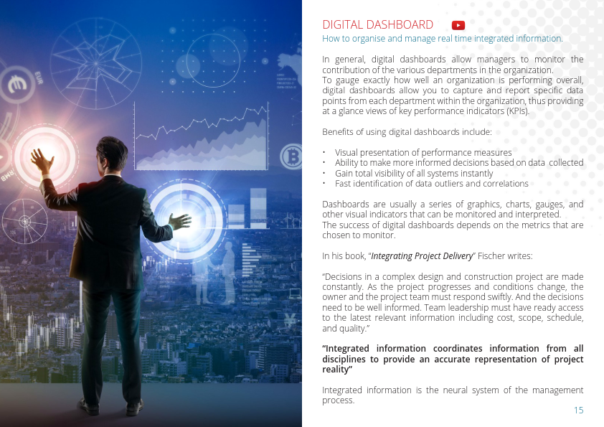
DASHBOARDS – visualization of the collected data
Visual presentations of the collected data
Make decisions
Visibility of all systems in real time
Fast identification and correlations
Visual alarming mode

Slide 16
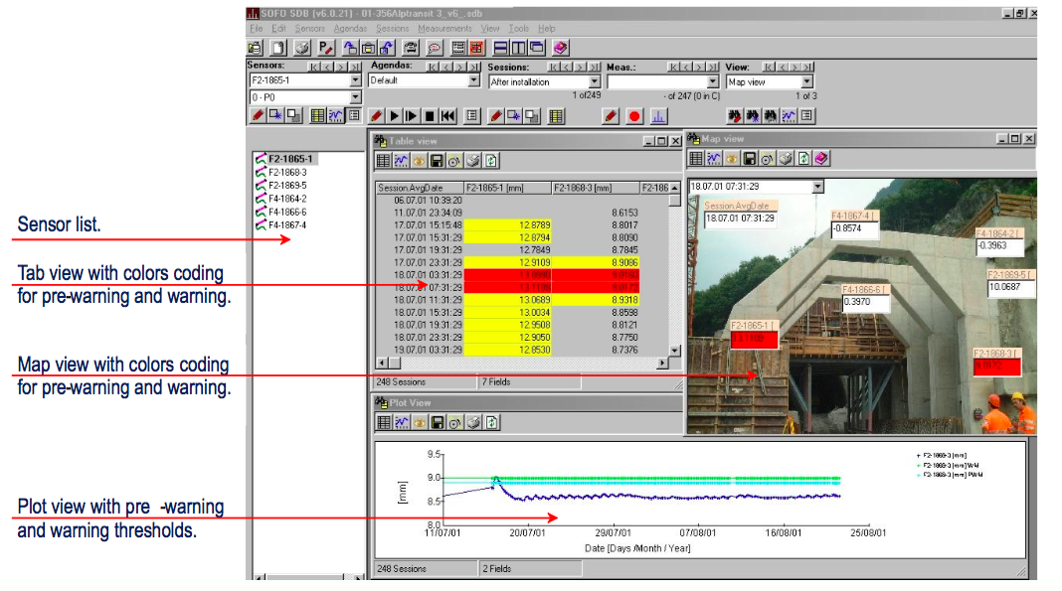
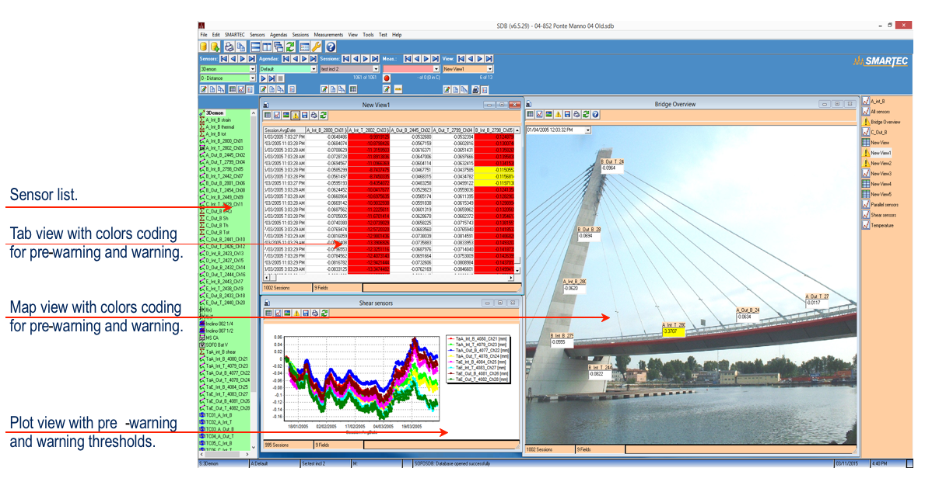
Alarms & Analytical results for structures
equipped with SHM solution

Slide 17
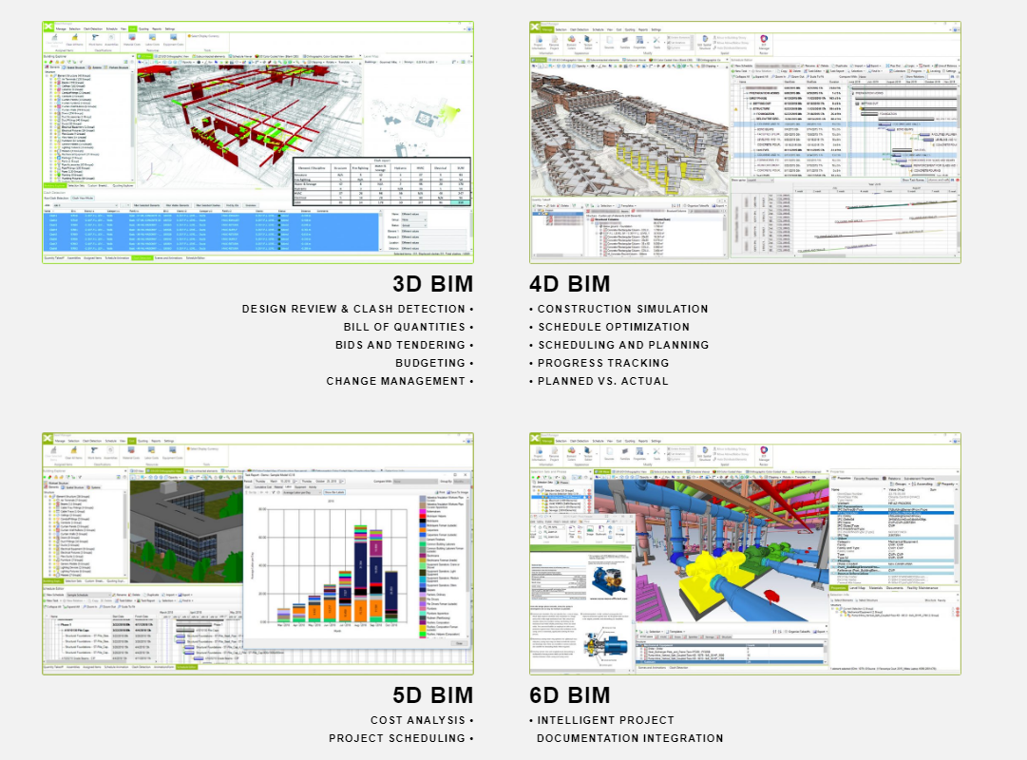

BIM modelling
Tekla Middle East BIM Awards 2018
DUBAI Museum of the Future

Slide 18

Key Takeaways
Digitalization in Construction Industry starting to develop
Efficiency & Cost saving, Better Control, Increased Safety
Aging infrastructure – increasing need for risk mitigation
Decisions based on real time measurement
IoT & BIM powerful tool in expert hands
Important to cooperate and co-create with partners – complex and different solutions and expertize needed

Slide 19
Construction tools - 3D print & scan

Slide 20
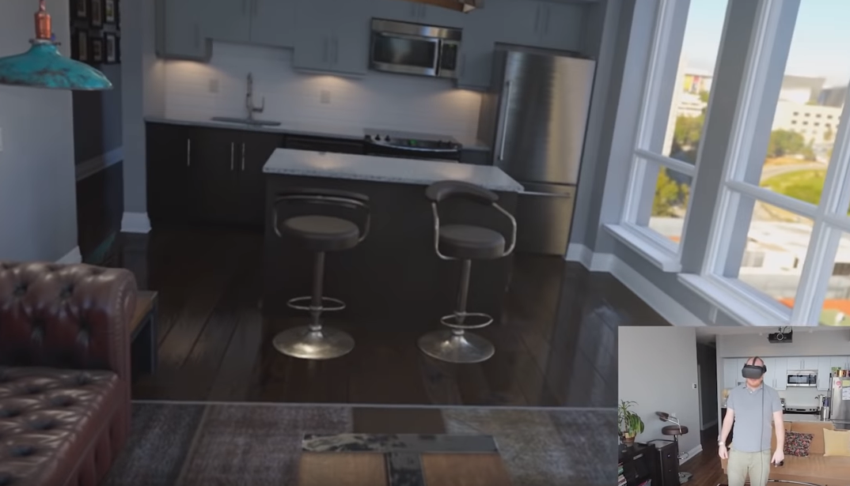
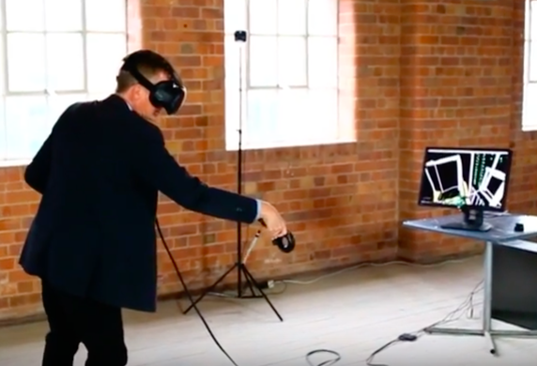
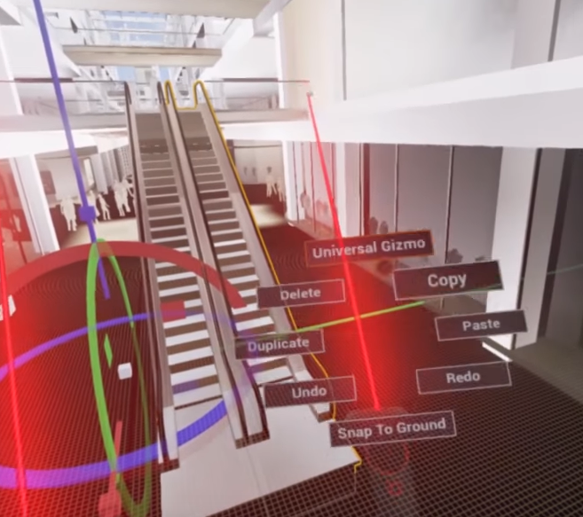
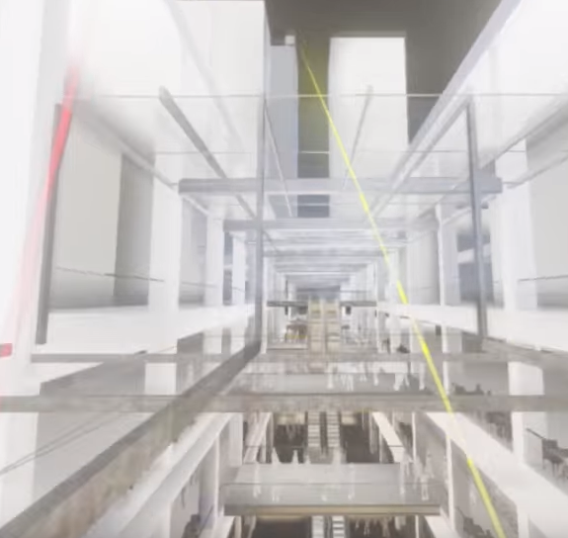
# Virtual reality
Source: VR Virtual Reality architecture by Bryan Howard
Source: Leonard Design Architects * 2016

Slide 21
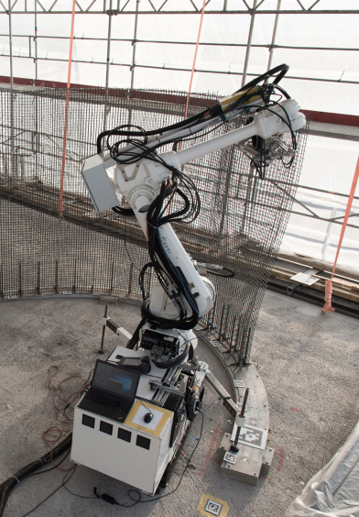
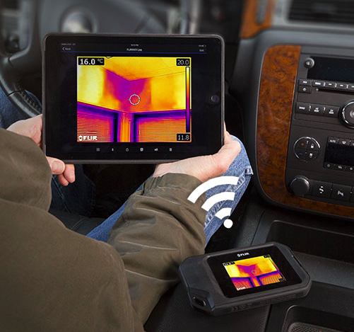
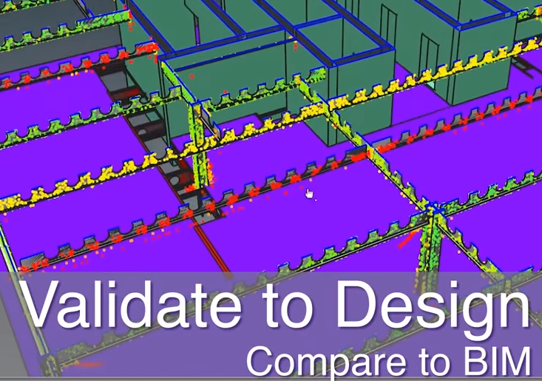
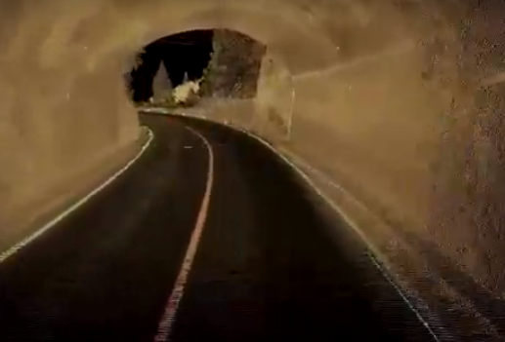
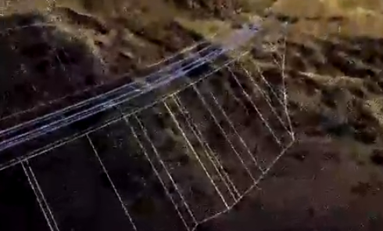
# 3D Printing #3D Scanning

Slide 22
4 principle strategies to capture value
… from available technologies in construction industry
Take a moment and think about your FUTURE digital strategy style
Lag – There is no urgency, we will wait and observe ... Mafi mushkila!
Follow – Instead of own development we will lean on partners
Lead – We exist to shake and shape our Industry
Collaborate – Share the ideas and knowledge to progress sociaty

Slide 23


Collaborative does not mean necessarily …
Future Site Engineer Lawyer from the Future

Slide 24
Risk assessment/Challenges
  Intellectual Property Rights
  Responsibility for connectivity, reliability on Broadband & Cloud
  Data protection rights, access limitations
  Security of Data (transmission and storage)
  Liability for smart devices operation
  Availability of Power Supply – no power, no tech!
  Communication and understanding others talking tech language

Slide 25
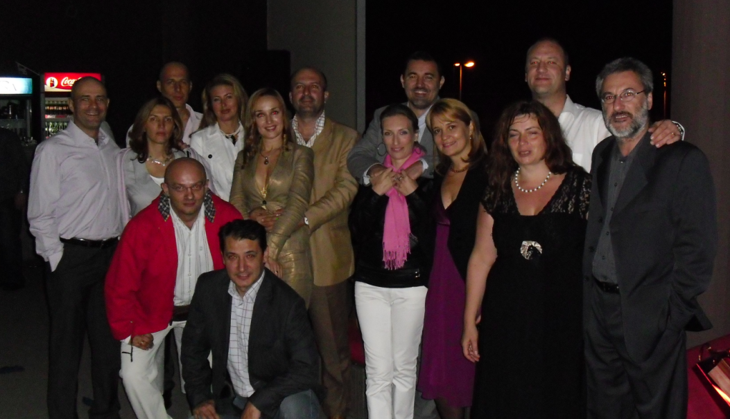


PEOPLE in FOCUS – monitor the shifting
Demographic and social changes including generation shifts in workforce
  Baby boomers (1946 - 1964) … "Been there, done that"
    Hardworking, loyal, confident and competitive
    Prefer "face to face" and detailed meetings or phone calls. Believe that no news is good news
  Generation X (1965 - 1981) … "Wait and see attitude"
    Anti authority, self-reliant and have a family focus
    Prefer clear communication on emails and hate/avoid clichés
  Generation Y (1982 - 1995) … "What's in it for me?"
    Digital thinkers, feel entitled, needy
    Prefer frequent feedback and solving via technology, not meetings
  Generation Millennials (1996 + ) … still under the scanner …
    Noted: does not care to possess, but to use assets and enjoy
New professions, knowledge, new language and signs
Source and inspiration: Presentation by Liv Kari Skudal Hansteen, Vice President EFCA, June 2016 Efca Board meeting, “What can we as EFCA and associations learn from Sarah Sladek's book ‘End of membership as we know it’?”

Slide 26
What we should do?
Stay calm, and try to understand how to use and control available technology
Talk to youngsters, even better listen what they are trying to say
Education and trainings / hints #Collaborative #BIM #IoT #VR #3DScan
Push necessary standardization in Europe (i.e. Smart cities and communities, IoT, SHM, BIM)
Find incentives to wake up our industry
Create or lobby for funding i.e. Europe to support development of solutions and new technologies implementation in construction industry
Communicate and do not hesitate to share your ideas

Slide 27
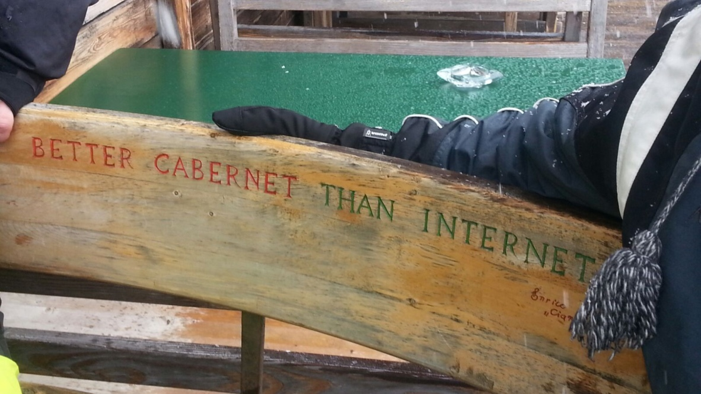


Nikola Vladislav Matić
VMS d.o.o. Beograd
Consultant Engineers
The European Federation of
Engineering
Consultancy Associations
Mail to: nma@vms.rs
Cell/Viber/What’s up
+381 63 252022
Skype nma.nikola
“When you’re finished changing, you’re finished.” Benjamin Franklin

